Slide 1
LEGOCIE FOOD PROJECT
Food Event at Blackfriars
Sunday 2nd February 2014

Slide 2
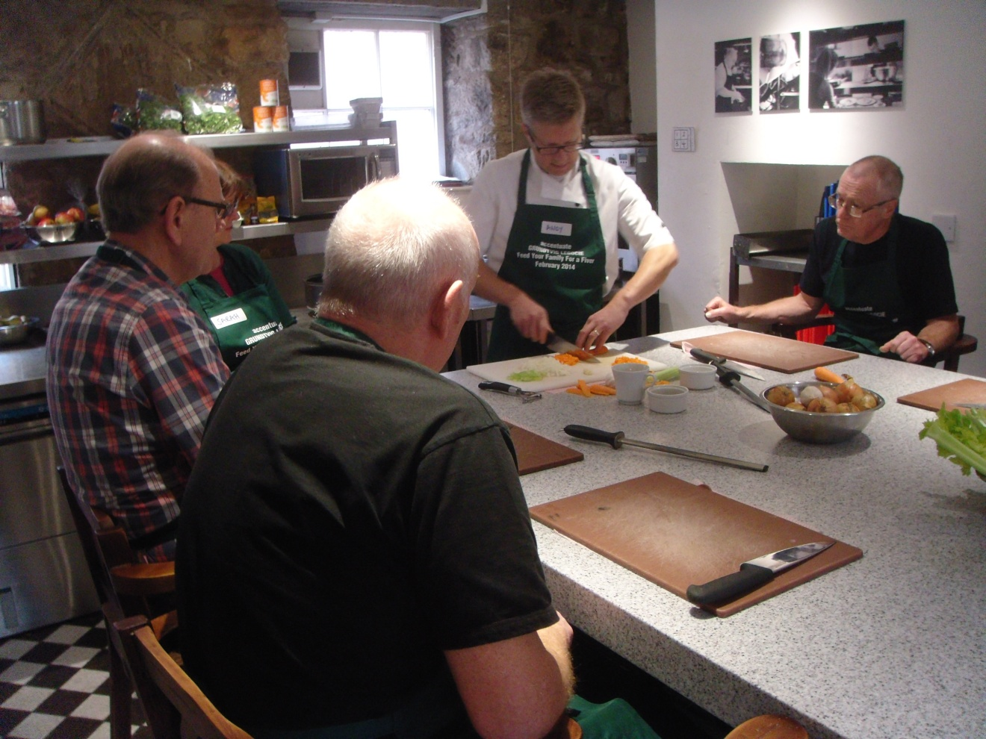
Andy demonstrating chopping

Slide 3
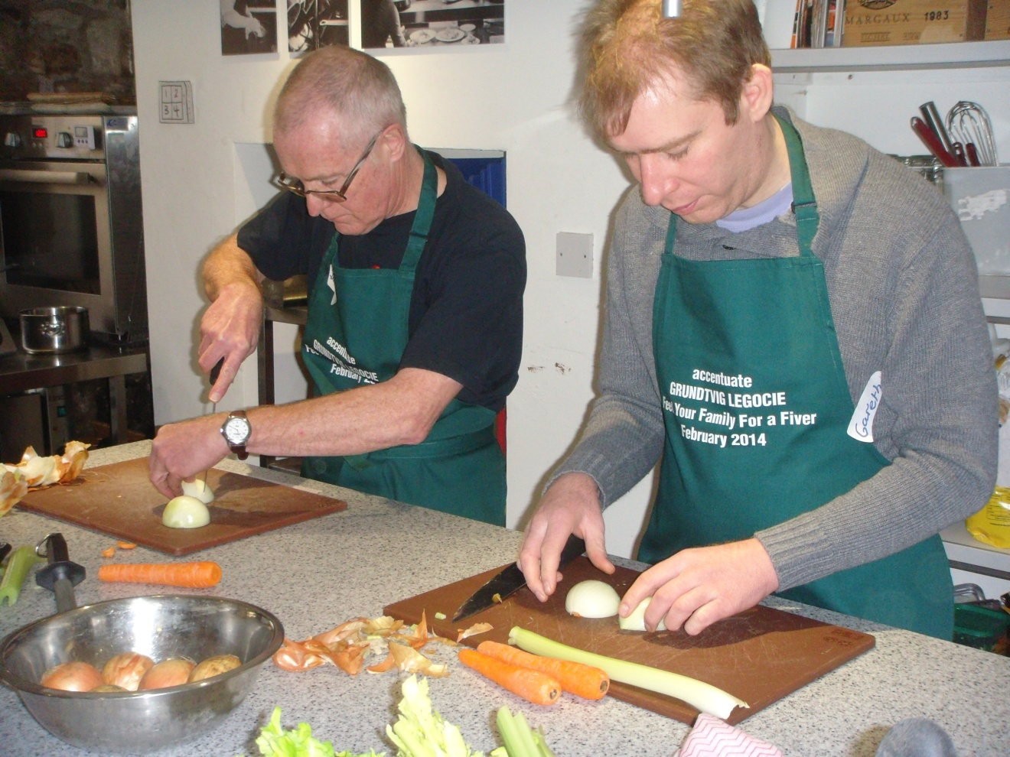
Dads learning to chop an onion.

Slide 4
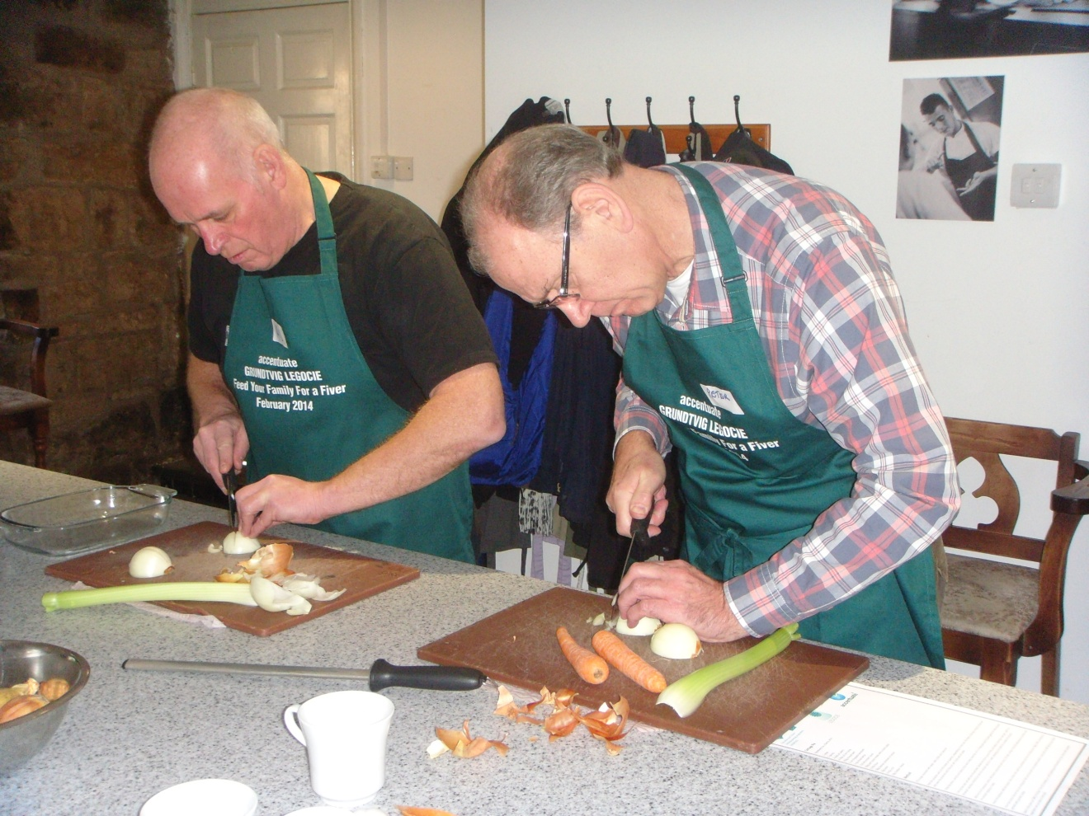
And now on to celery and carrots……..

Slide 5
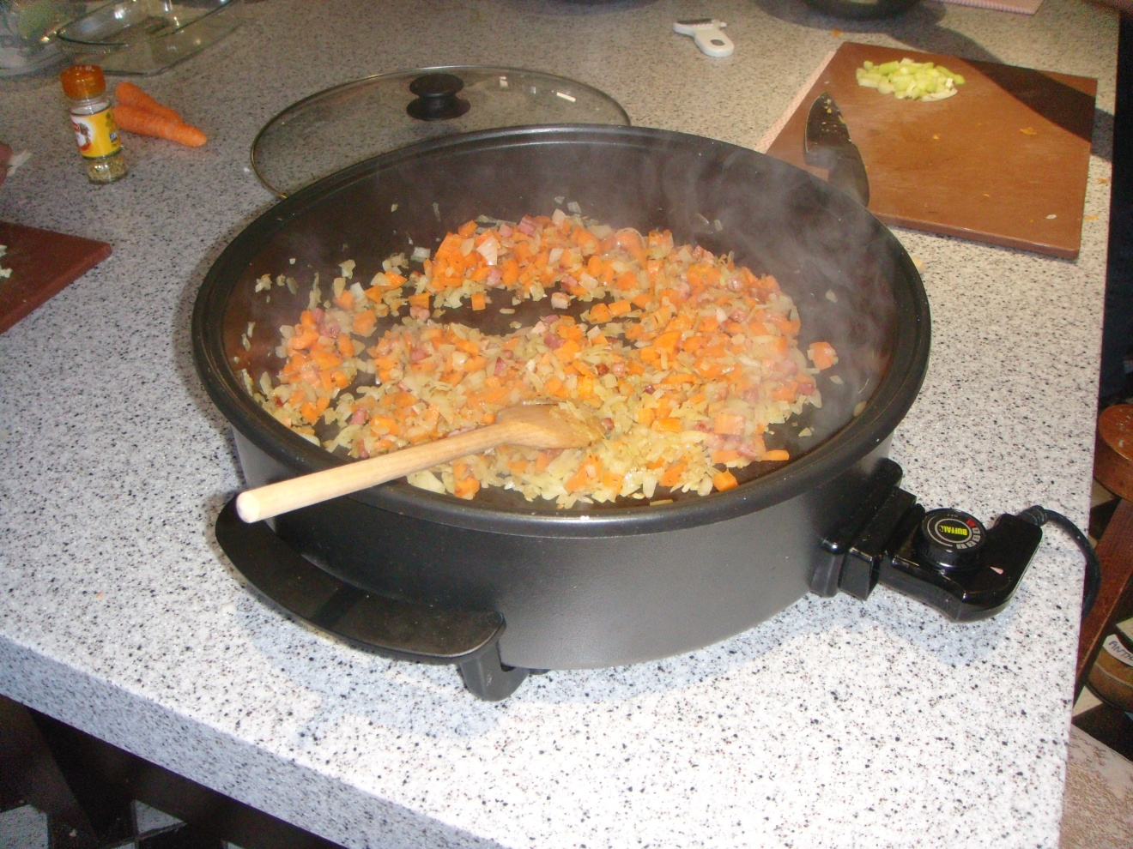
It’s all progressing nicely!

Slide 6
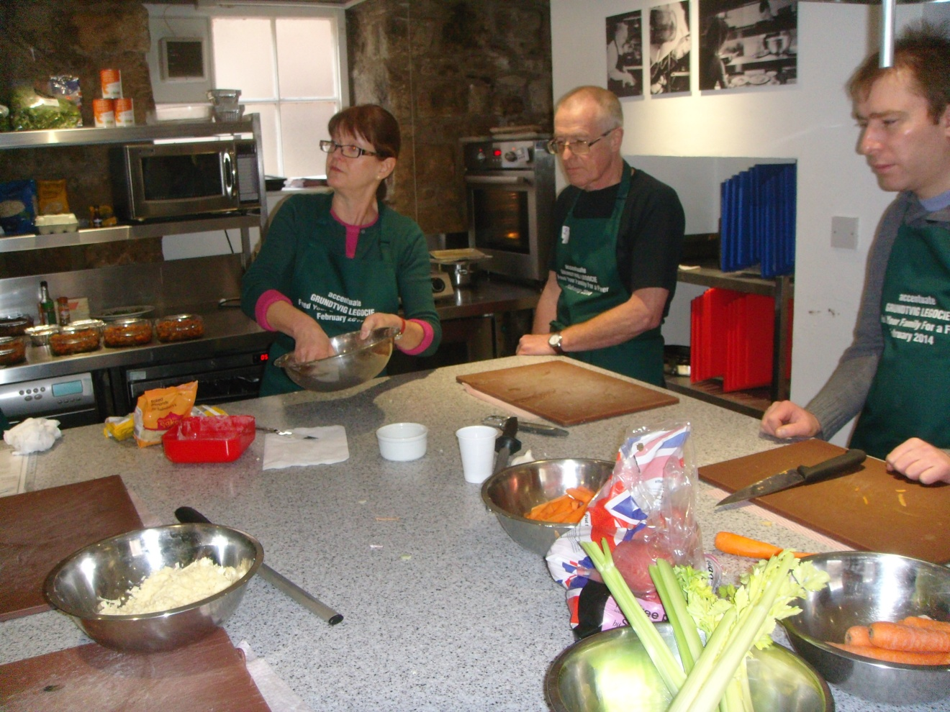
Sarah demonstrating crumble.

Slide 7
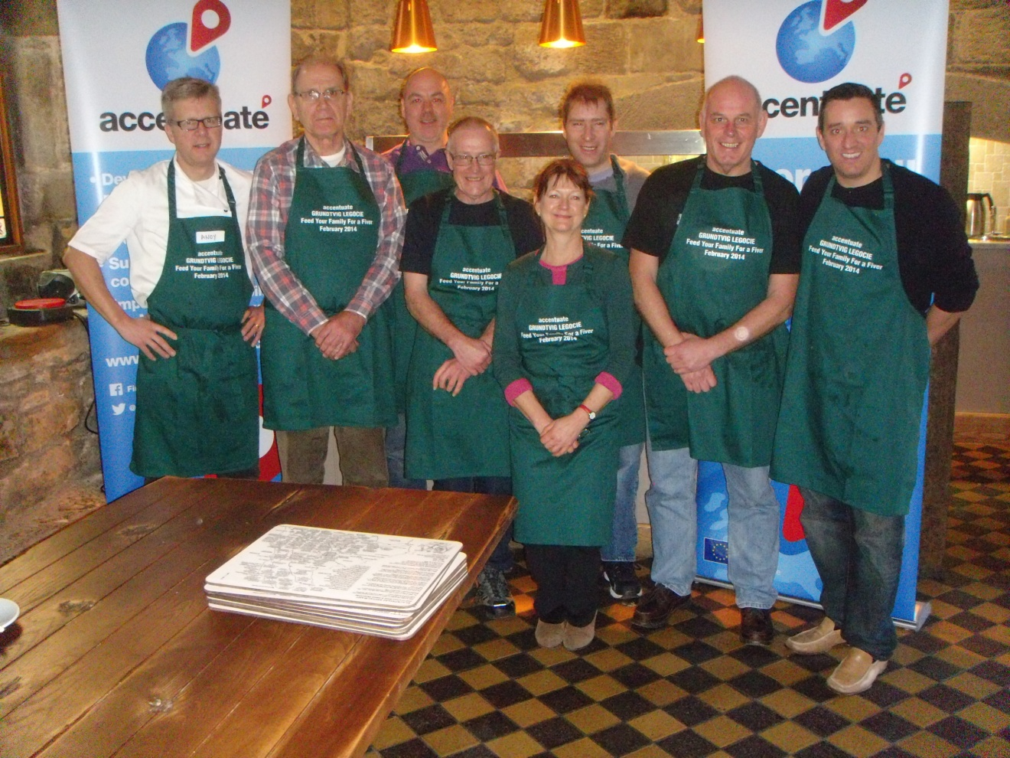
Here’s the team, Cottage Pie and Crumbles in the oven, so everyone’s smiling!

Slide 8
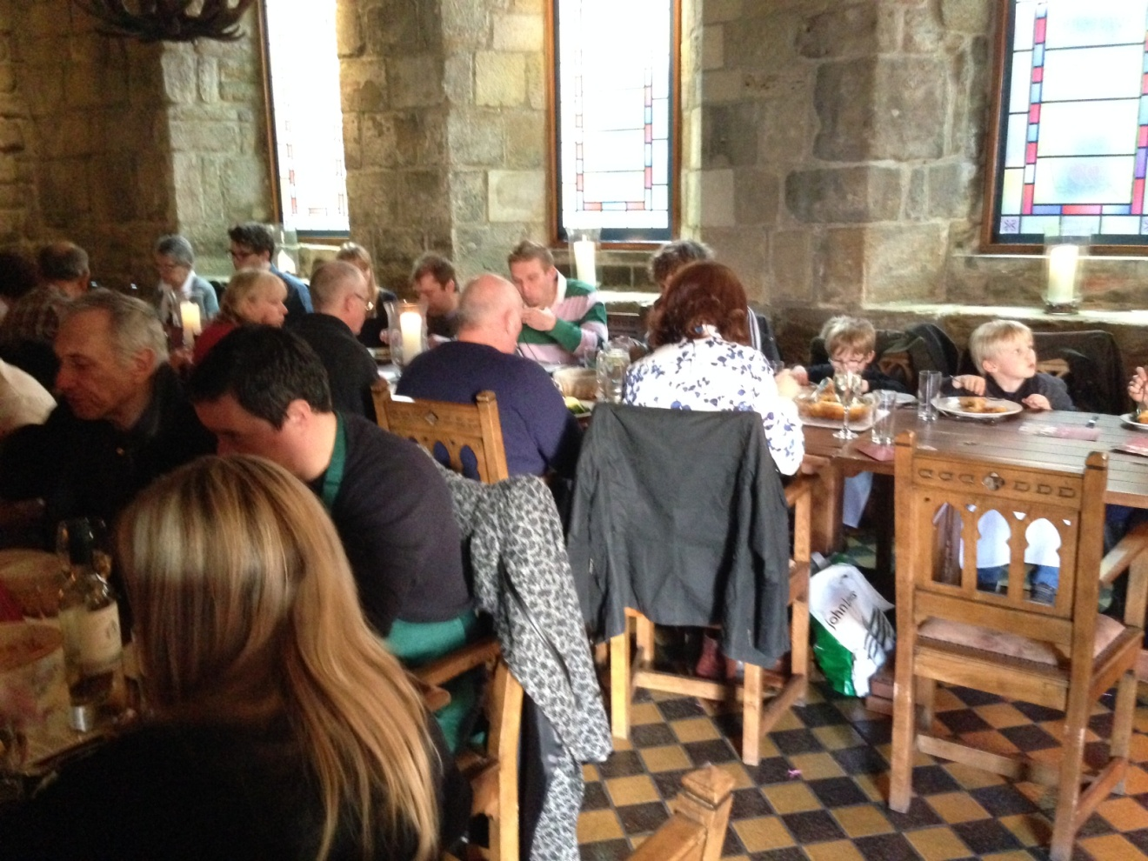
Everyone’s families tucking in to a healthy Sunday lunch.

Slide 9
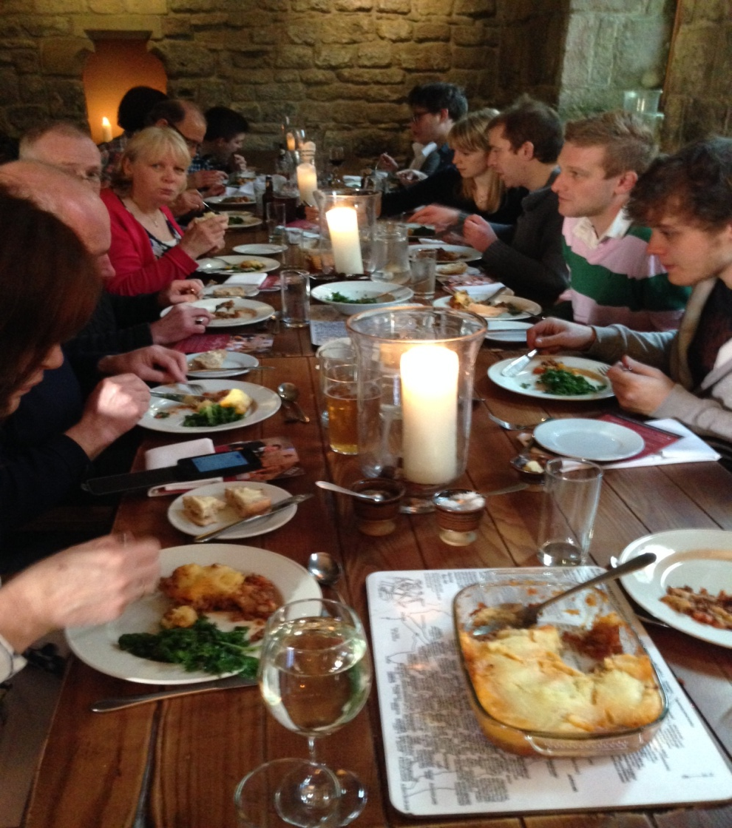
What a great occasion!

